Slide 1

Research Question Is there a difference in the mean resale price of cars between different fuel types? Date:
Emma Harrison
Mahamad Alfaiz Javidbhai SaiyadMahamad Alfaiz Javidbhai Saiyad
Marshal Ashokkumar PachaniMarshal Ashokkumar Pachani
Muhammad Waleed AshrafMuhammad Waleed Ashraf
Rutvik Kishorbhai VadherRutvik Kishorbhai Vadher
A 36 A
5 students
Group Name: A035 Name of Student Presenting:

Slide 2
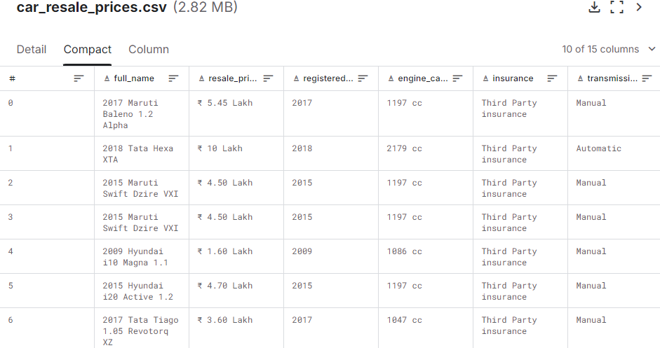
The dataset has 17,447 rows.
The dataset captures key information about cars, including their resale price, fuel type, and other features like mileage and engine capacity.

Slide 3
This dataset is interesting to us because : Resale value often impacts purchasing decisions. Thus, it is interesting to see how the car fuel type has an affect on the resale price From the column headings in your dataset choose ONE independent * and ONE dependent variable . Our Independent variable is: (Fuel type) This Independent variable datatype is (select one): Nominal/categorial. Our Dependent variable is: (Resale price) This Dependent variable datatype is (select one): Interval/measurement data.
Dataset ID: (DS261 number and Car resale data - 2023)
Notes:
Before specifying your Research Question you must define the type of data you are analysing. Are the variables you select interval data (measurement data you can divide, multiple, etc), OR are they ordinal (there is a definite order but the intervals between each variable are not necessarily equal, or the terms might be subjective like in a likert scale); OR are they just categorical/nominal (Items such as film names, cities, etc., that you can count numbers of occurrences? You also need to understand whether the variable is either dependent or independent and this will vary according to the context. Independent variables may cause an effect, whereas the dependent variable might be effected by the independent variable. Check the lecture notes on the RQ for more information and examples.
You will get only one opportunity to present your Research Question ahead of the submission date. Have your questions ready, and be ready to take notes on feedback.

Slide 4
Template² :Is there a difference in the mean resale price of cars between different fuel types?
Our Research Question is Choose ONE of the three templates below replacing the blue text with your variables – then add hypotheses as shown in next slide:
¹Correlation (Analysis of how ordinal/interval dependent var correlates to an ordinal/interval independent variable)
²Comparison of means (or medians): Analysis of the difference between the mean (or median) value of a characteristic shared by members of two different populations.
³Comparison of proportions: Analysis of the difference in proportions of a characteristic shared by members of two different populations.

Slide 5
Add your Hypotheses to the previous RQ Slide (both the Null and Alternative Hypotheses). Here are definitions and examples. Your wording will come directly from your RQ. This is the formal way of reporting the results of your inferential test statistics, in which we report the effect the independent variable has on the dependent variable –
Null hypothesis (H₀): There is no effect on the population – so you write one of the following:
Null hypothesis (H₀): There is no difference in the mean resale price of cars between petrol and diesel vehicles. or
2. Alternative hypothesis (H₁): There appears to be an effect on the population – so you copy what you wrote for the Null hypothesis but remove the ‘no’ and replace with ‘a’ For example:
Alt hypothesis (H₁): There is a difference in the mean resale price of cars between petrol and diesel vehicles.
Leave the hypotheses as two statements for now – after your statistical analysis test, you will choose one or the other. (You will report: "We fail to reject the null hypothesis" with no significant result, or if you do have significance [p-value = < 0.05] you can state "We reject the null hypothesis". More guidance on hypothesis testing is given in the lectures.)

